Slide 1
CS 31 Discussion 5
TA: Tianxiang (Peter) Li
LA: Kyle Wong
LA mid quarter feedback survey: http://tiny.cc/LA-feedback

Slide 2
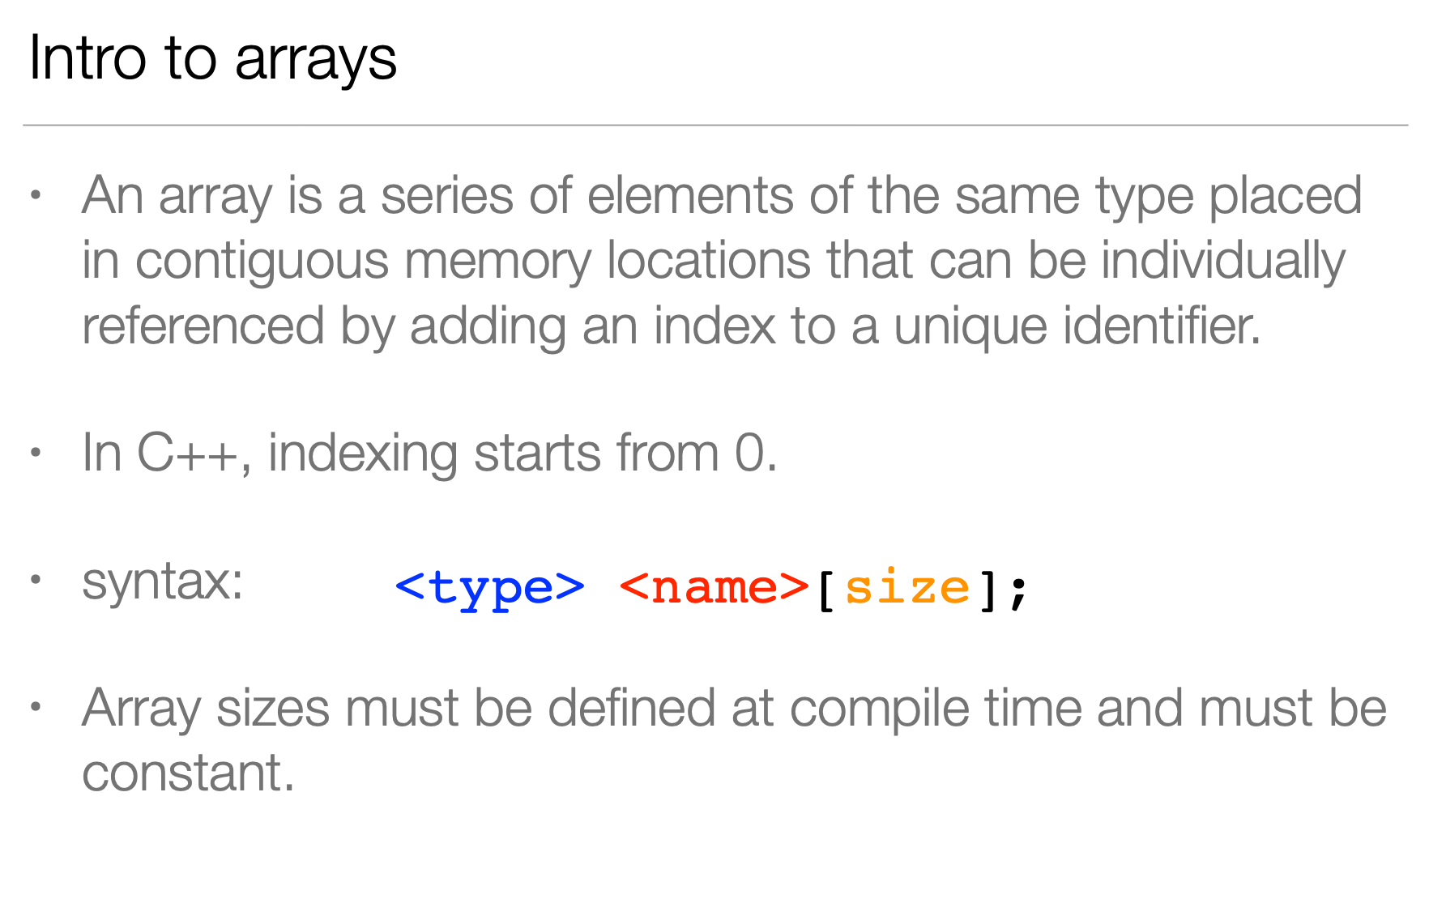

Slide 3
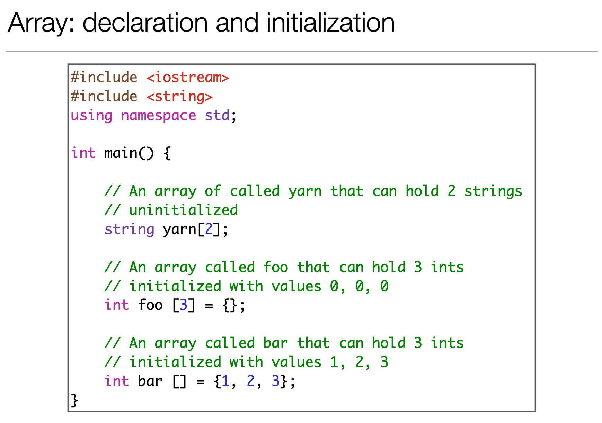

Slide 4
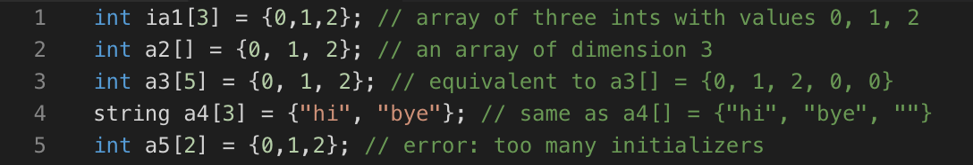
Array Initialization

Slide 5
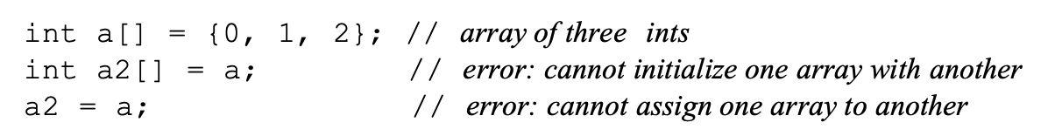
Common Mistakes
✅
❌
❌

Slide 6
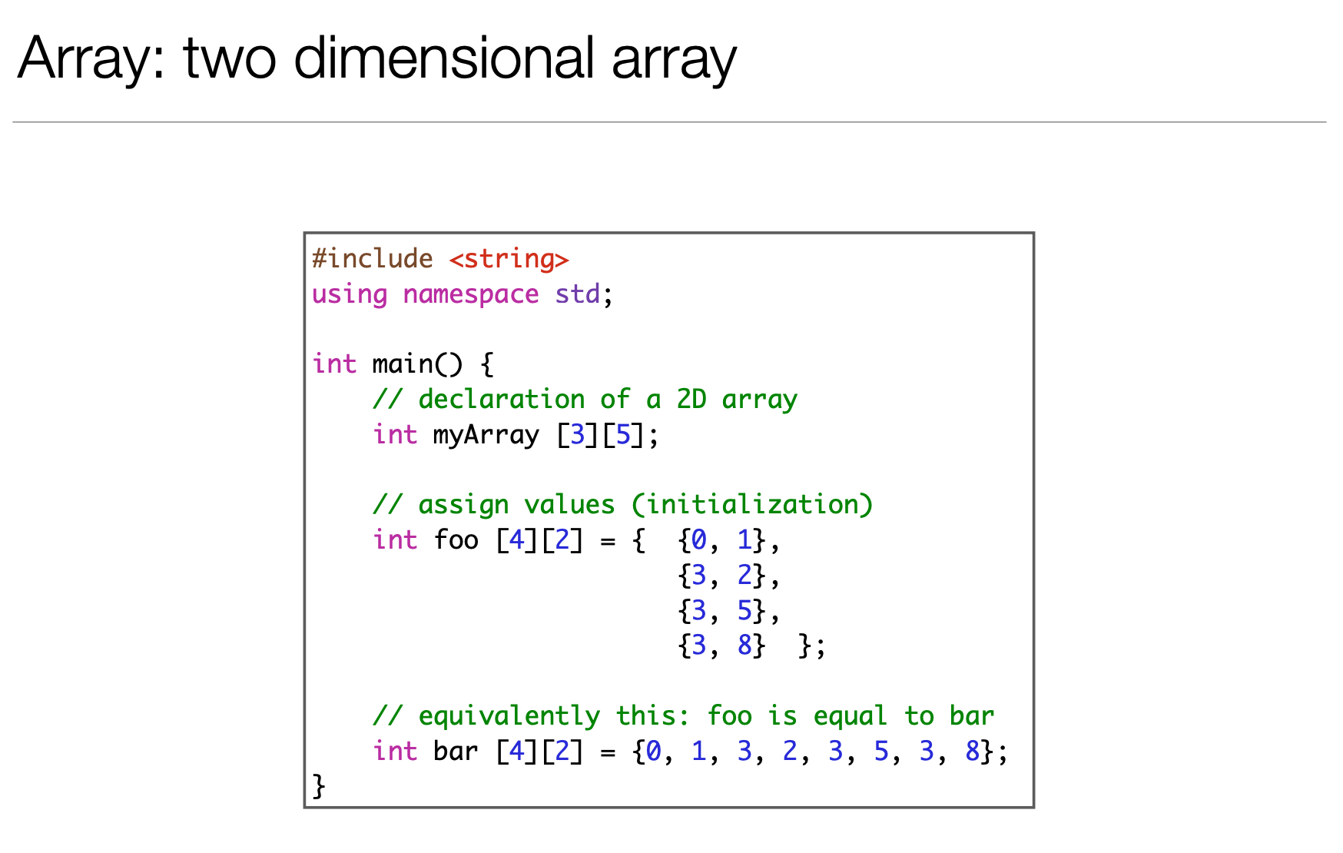

Slide 7
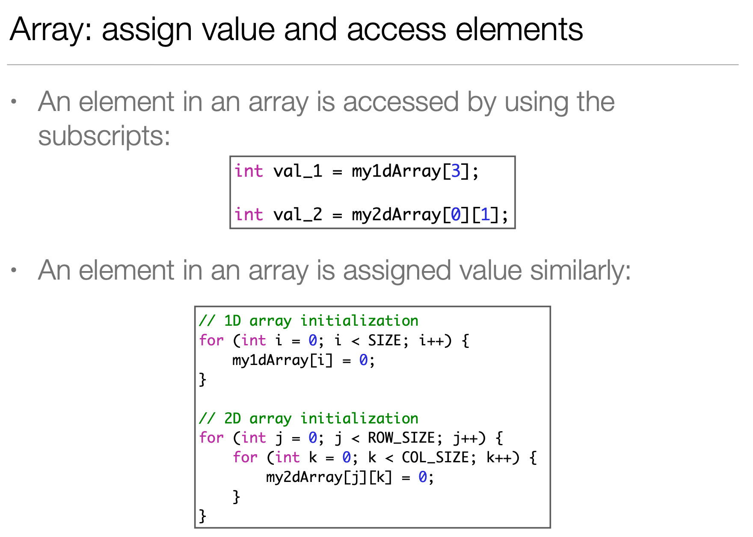

Slide 8
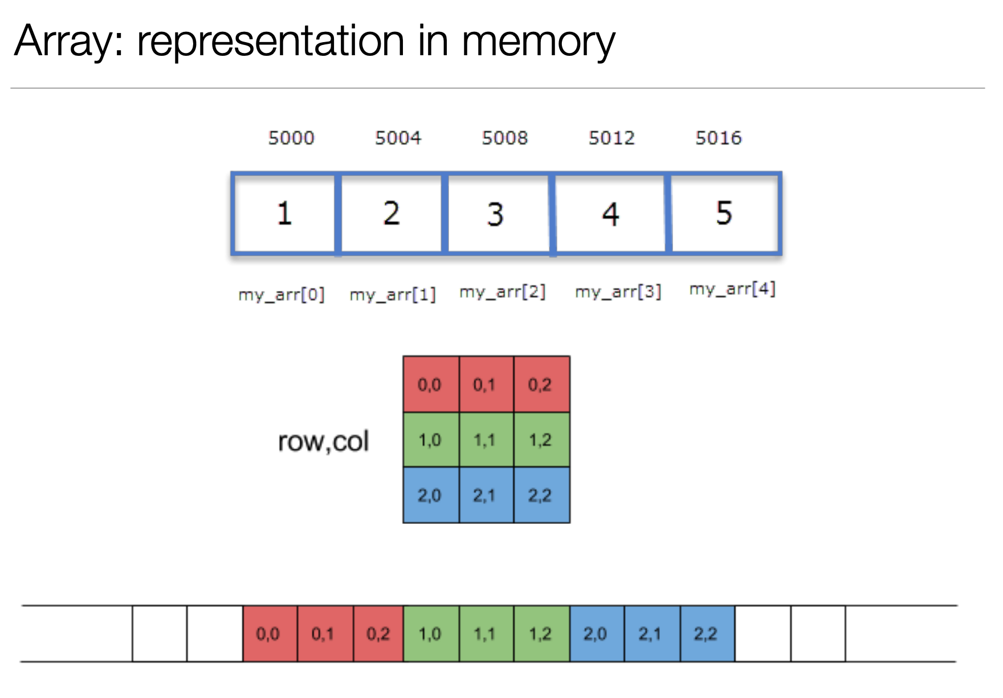

Slide 9
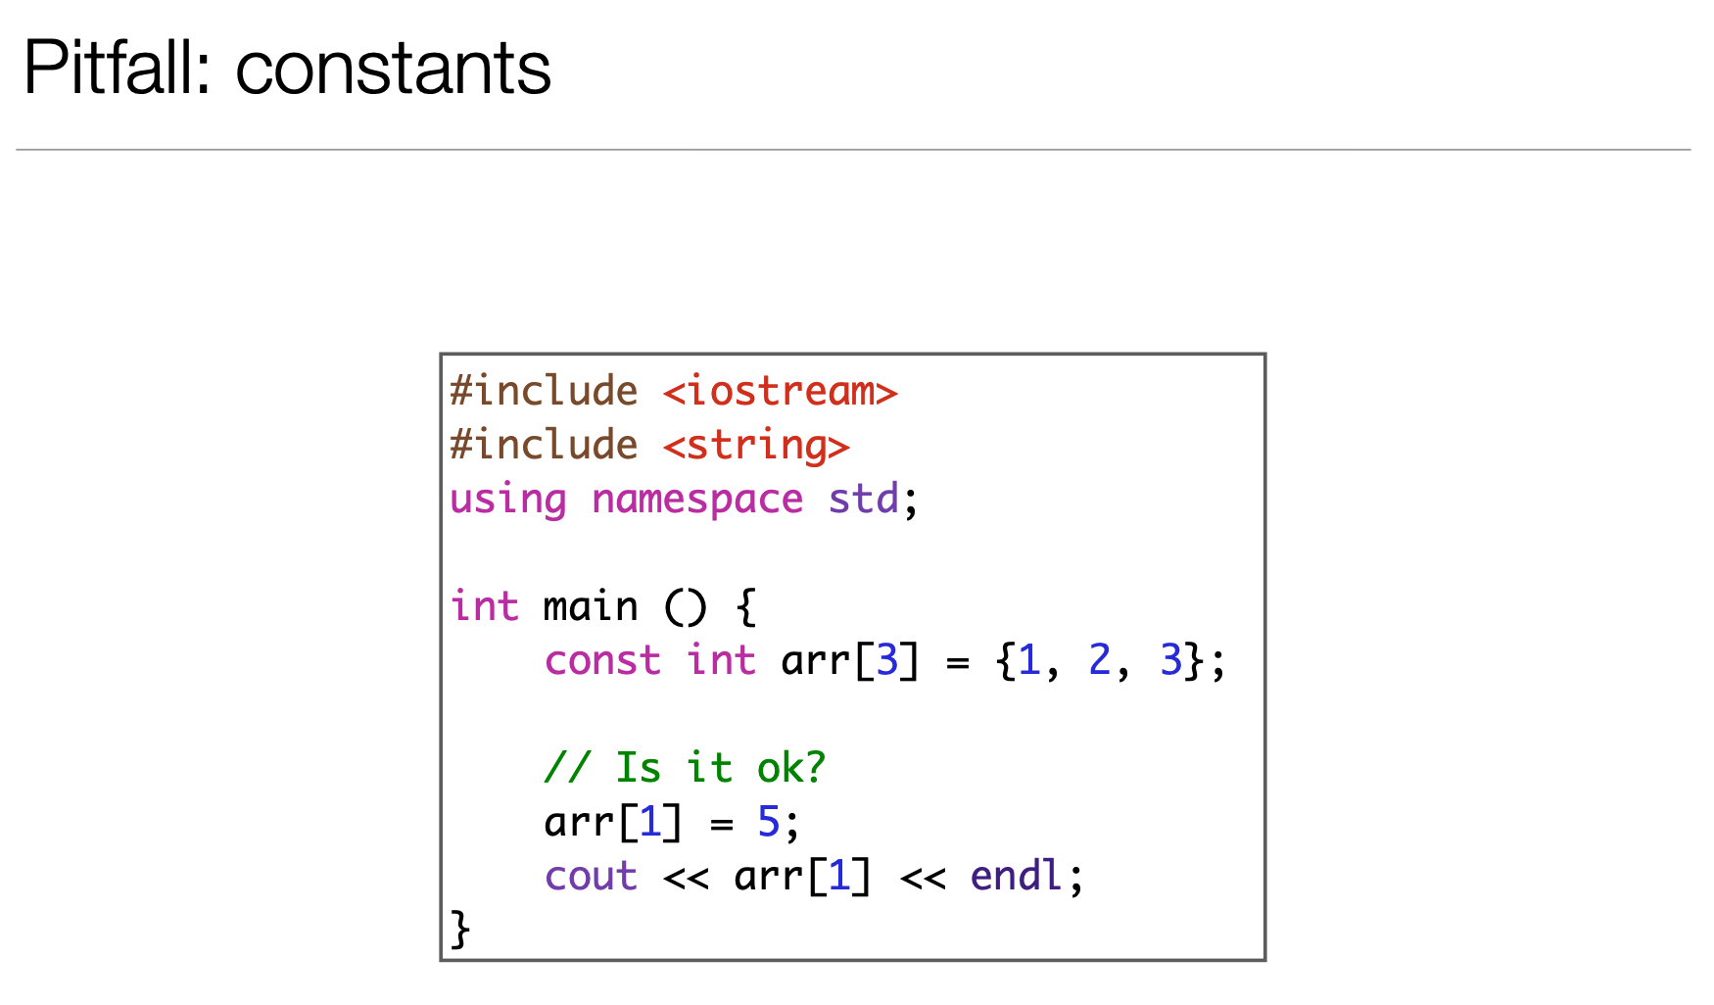

Slide 10
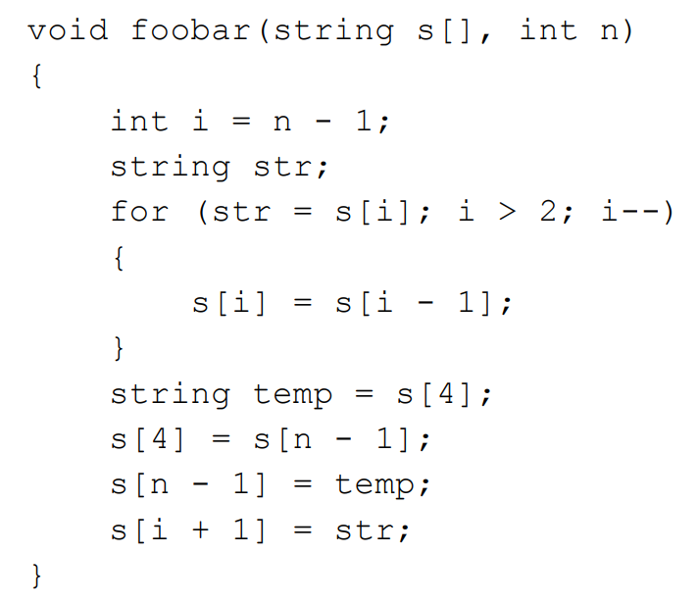
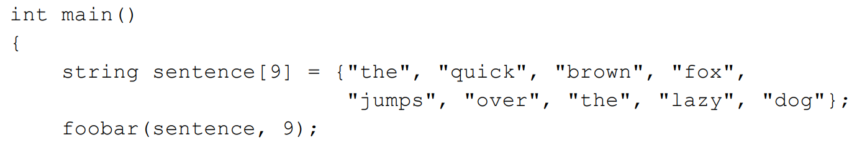
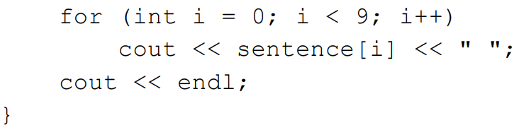

Slide 12
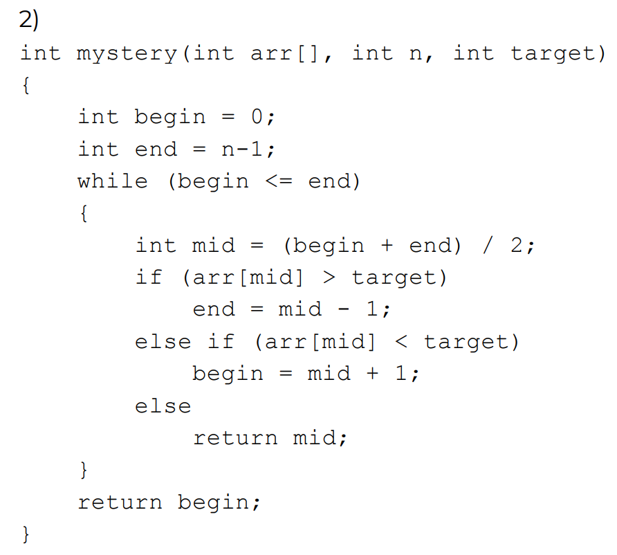
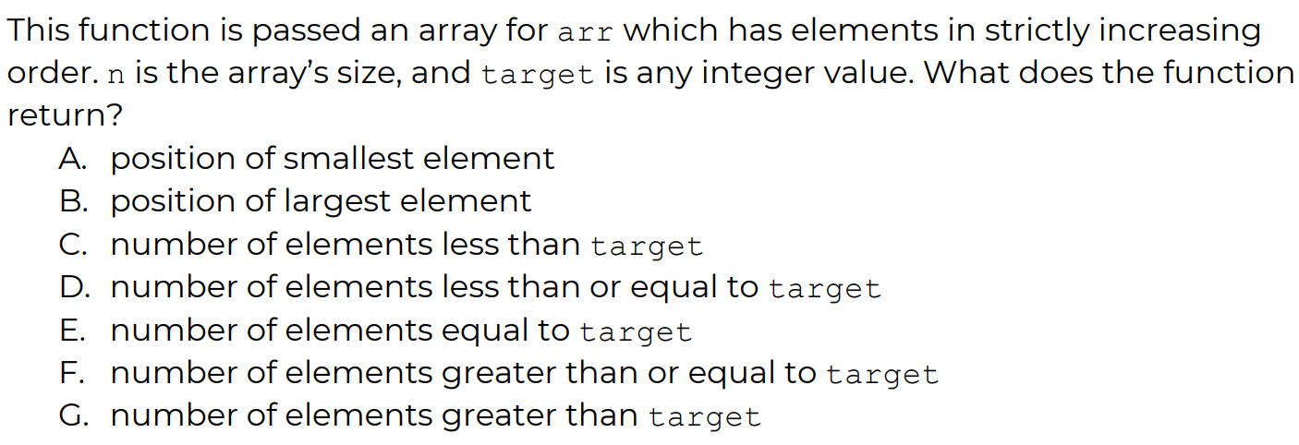

Slide 13


Slide 14
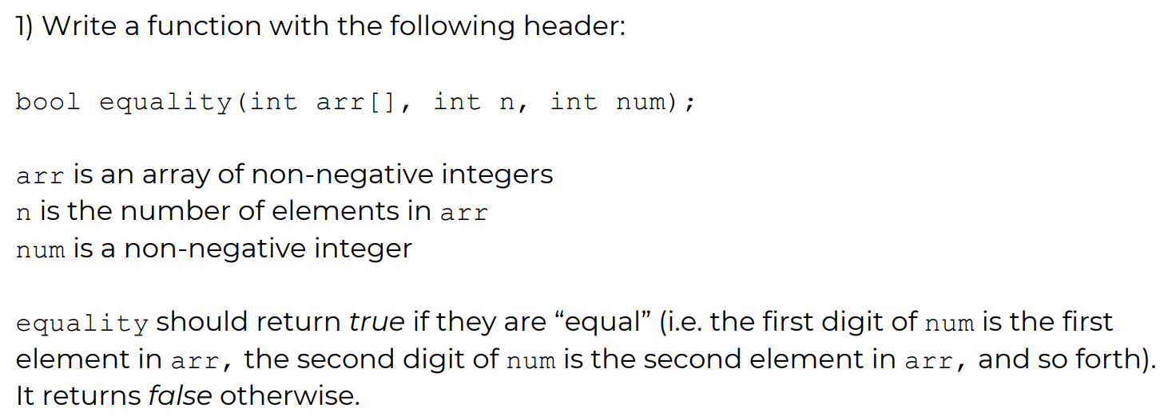
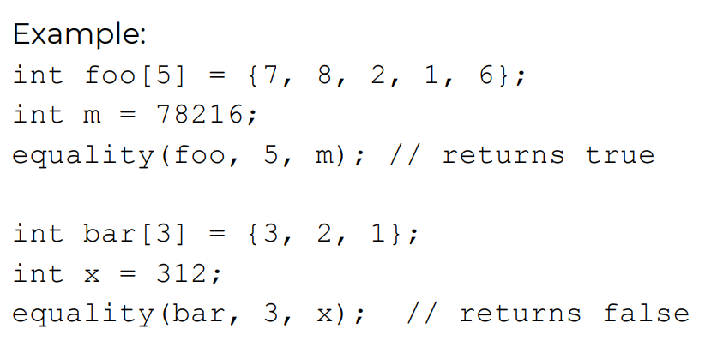

Slide 15
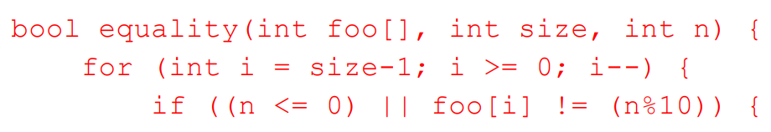
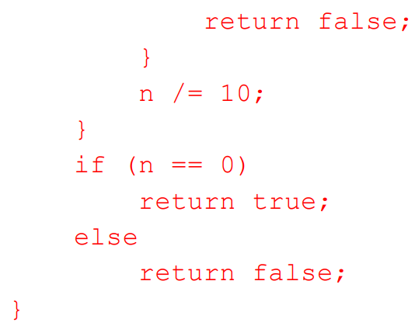

Slide 16
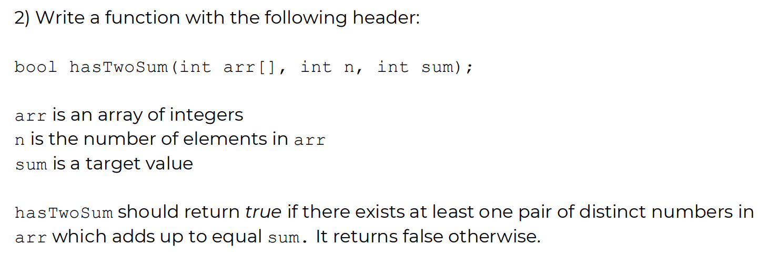
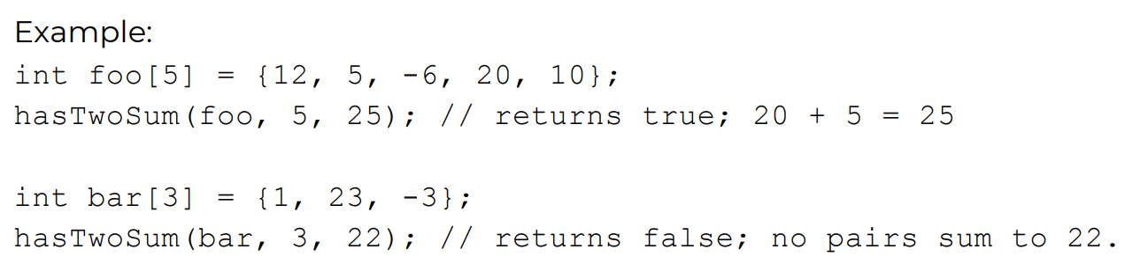

Slide 17
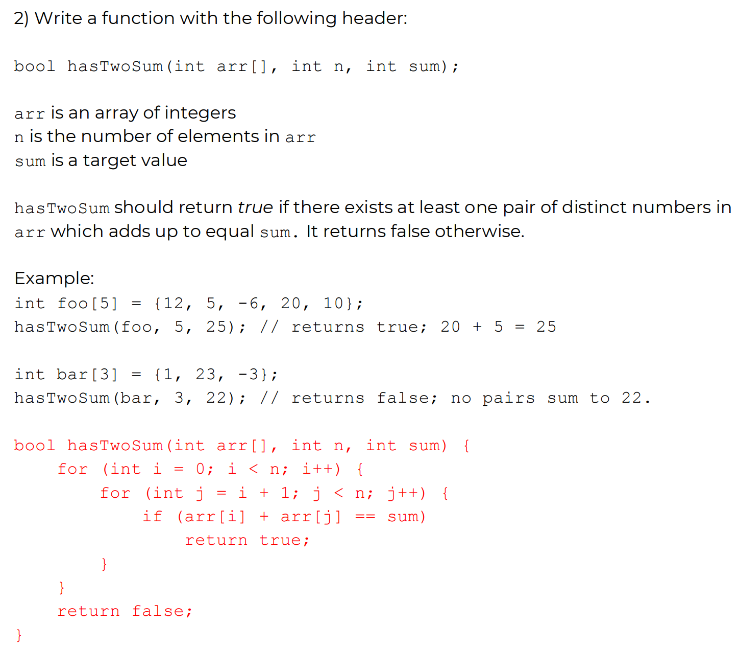

Slide 18
3Sum
bool hasThreeSum(int A[], int arr_size, int sum)
A[] an array of integers to check
Size of A[]
Whether there are 3 elements in A[] that can add up to ‘sum’

Slide 19
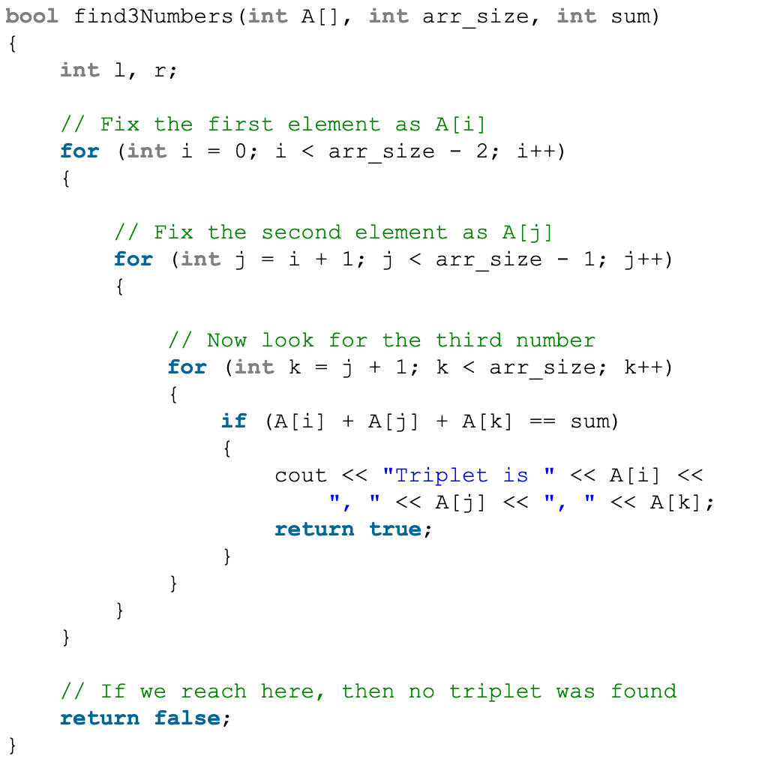
3Sum
Complexity: O(n^3)
Can we do better?

Slide 20
Sorting an array of integers
Selection Sort
Bubble Sort
Insertion Sort
Merge Sort
Quick Sort
…

Slide 21
Selection Sort (example: ascending order)
Sorts an array by repeatedly finding the minimum element from unsorted part and putting it at the beginning.
The algorithm maintains two subarrays in a given array.
1) The subarray which is already sorted. 2) Remaining subarray which is unsorted.
In every iteration of selection sort, the minimum element from the unsorted subarray is picked and moved to the sorted subarray.

Slide 22
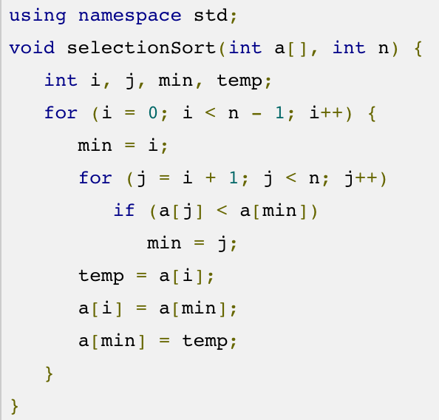
Selection Sort

Slide 23
Revisit 3-sum problem
If we have function to sort array in ascending order
Sort( int arr[] )

Slide 24
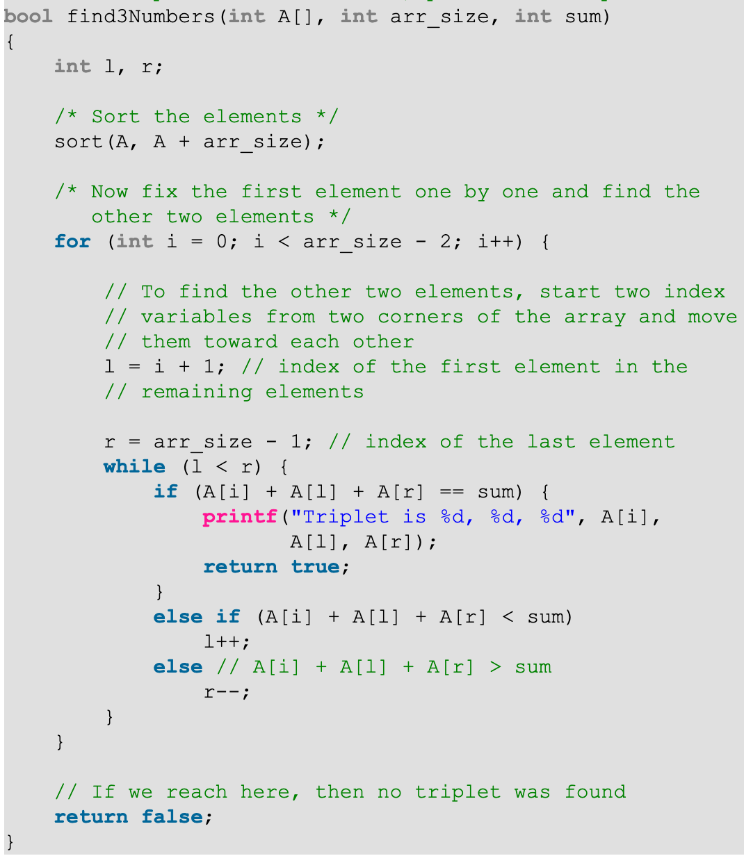
O(n^2)

Slide 25
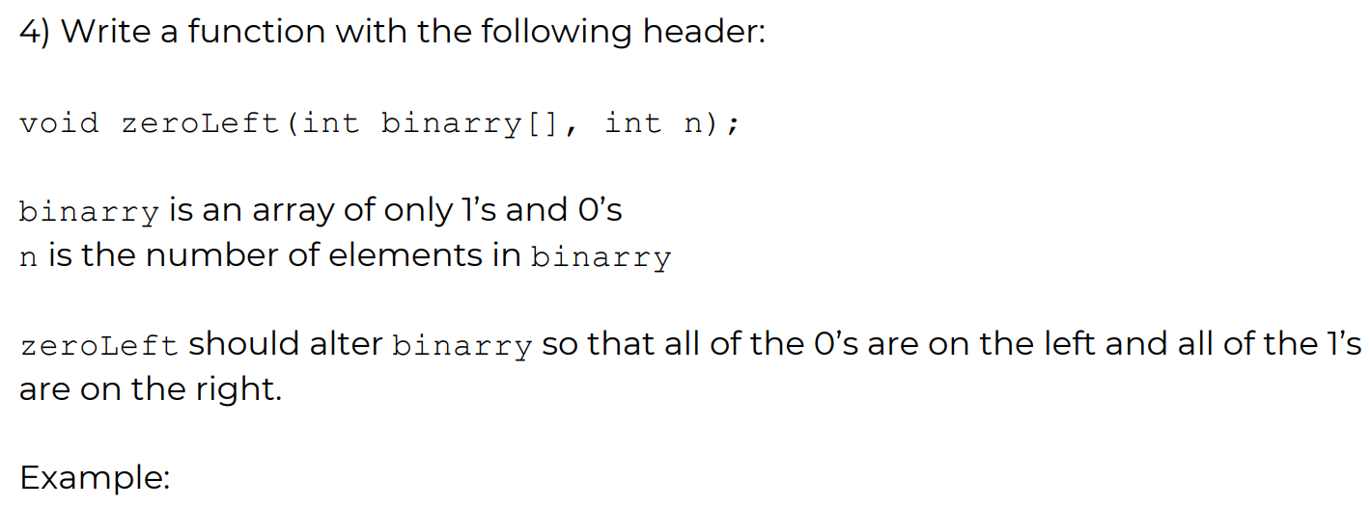
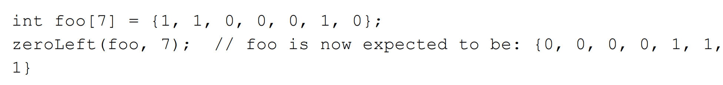

Slide 26
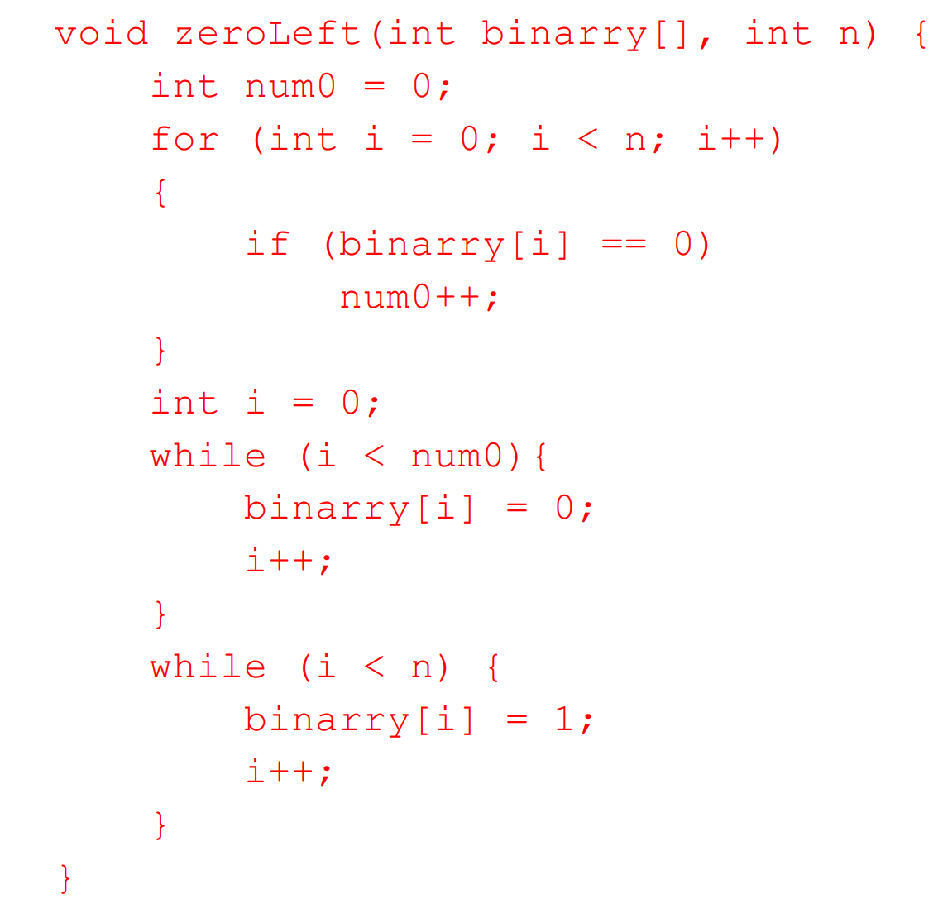
Solution

Slide 27
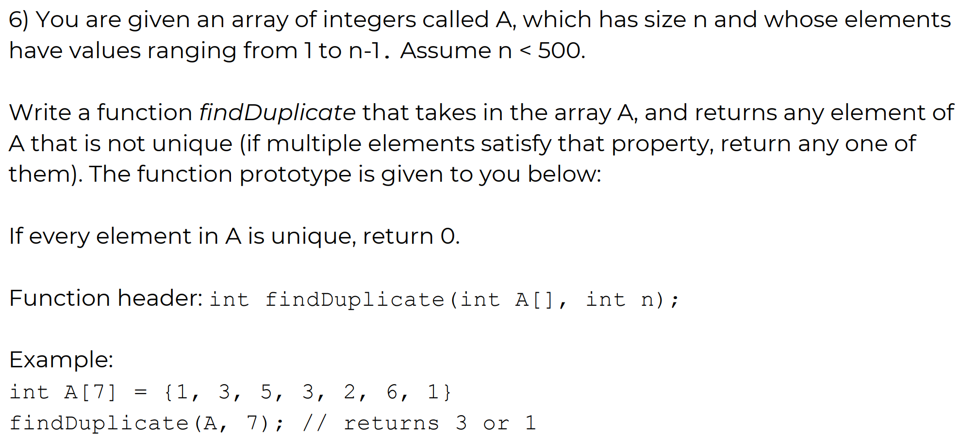

Slide 28
